Slide 1
CHANDIDAS MAHAVIDYALAYA
DEPARTMEANT OF GEOGRAPHY
Topic.- Population Structure
Prof.- Indrajit Mandal

Slide 9
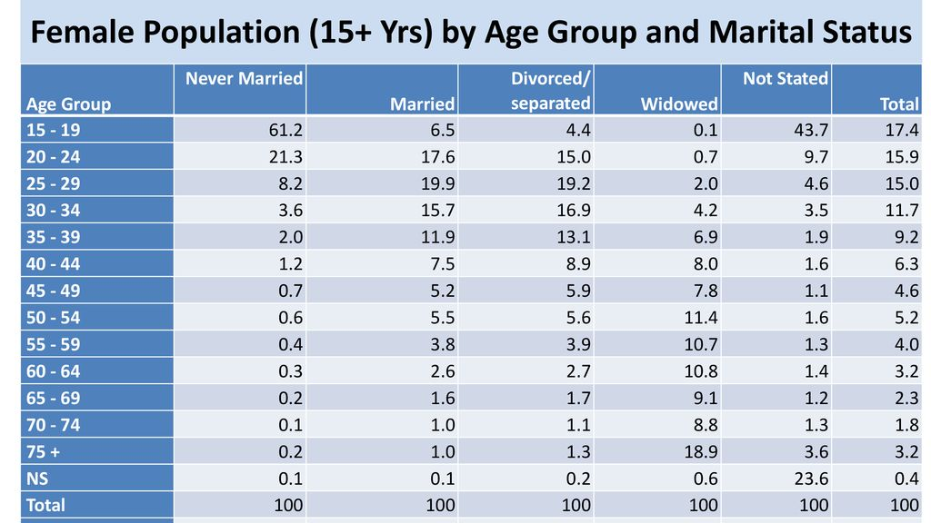

Slide 10
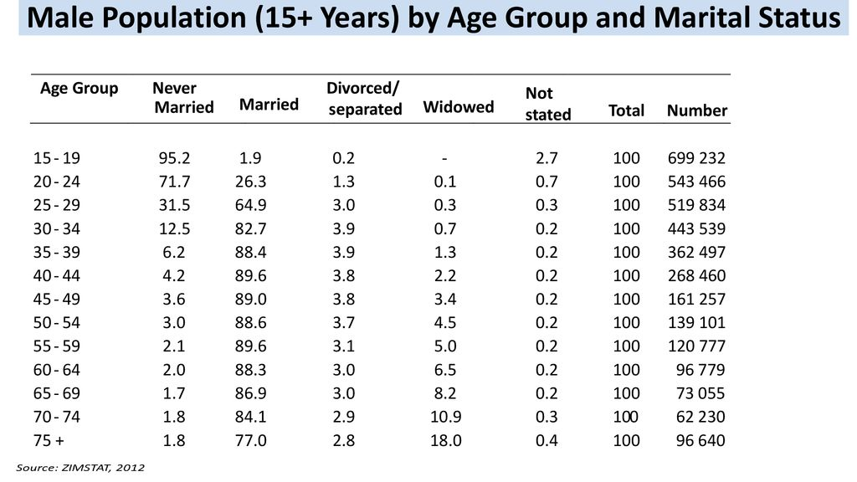

Slide 15
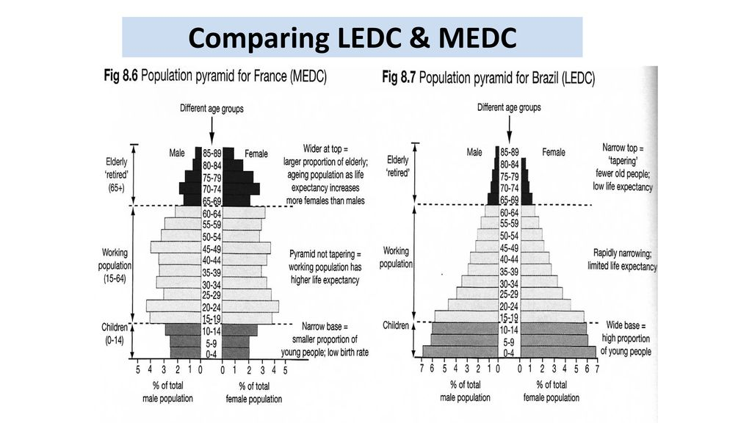

Slide 21
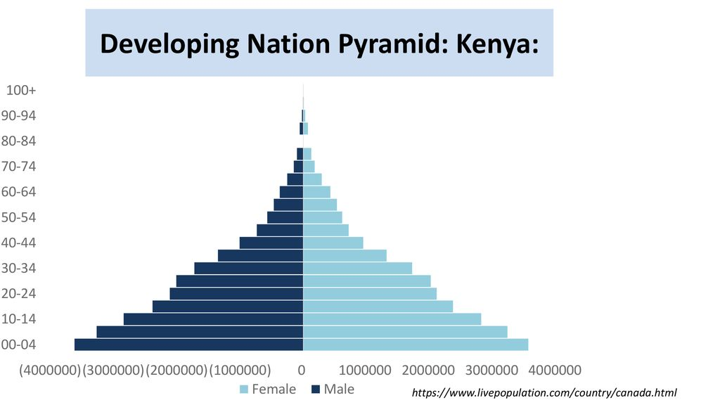

Slide 30
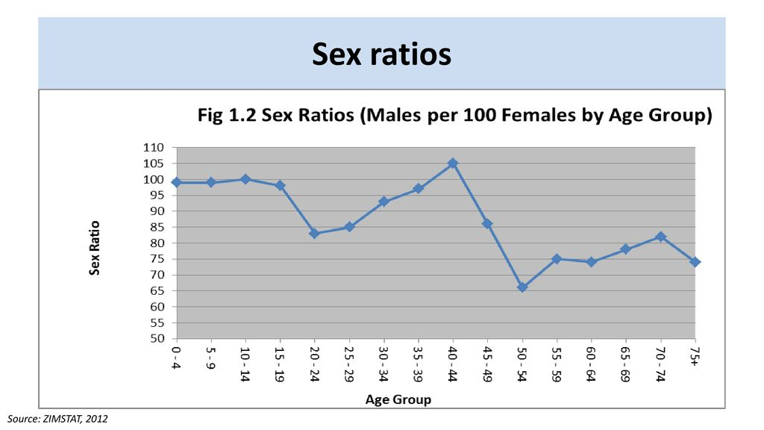

Slide 39
Thank you

